Slide 1

PaaS Cloud Goat (hacking custom Salesforce apps)
Rodney Beede
December 2024

Slide 2
About Me
Principal Consultant at Coalfire
Cloud security testing > 10 years
Multiple CVEs discovered
Started as J2EE software developer
M.S. in C.S. - "A Framework for Benevolent Computer Worms" 2012
Coalfire, Rackspace, Seagate, HP, Cisco, RiskMetrics (MSCI)
Presenter at: BSides, InnoTech, Black Hat, Def Con
https://www.rodneybeede.com/curriculum%20vitae/bio.html

Slide 3
Big List of Useful Reference Material
Security Tips for Apex and Visualforce Development
https://developer.salesforce.com/docs/atlas.en-us.apexcode.meta/apexcode/pages_security_tips_intro.htm
Using the with sharing, without sharing, and inherited sharing Keywords
https://developer.salesforce.com/docs/atlas.en-us.apexcode.meta/apexcode/apex_classes_keywords_sharing.htm
Considerations for Sharing and Accessing Contacts
https://help.salesforce.com/s/articleView?id=sf.contacts_sharing_considerations.htm&type=5
Cross Site Scripting (XSS)
https://developer.salesforce.com/docs/atlas.en-us.apexcode.meta/apexcode/pages_security_tips_xss.htm
SOQL SELECT Syntax
https://developer.salesforce.com/docs/atlas.en-us.soql_sosl.meta/soql_sosl/sforce_api_calls_soql_select.htm
Open Redirects
https://developer.salesforce.com/docs/atlas.en-us.packagingGuide.meta/packagingGuide/secure_code_violation_open_redirects.htm
Best Practices for Static Resources
https://developer.salesforce.com/docs/atlas.en-us.pages.meta/pages/pages_compref_additional_page.htm
Salesforce Object Search Language (SOSL)
https://developer.salesforce.com/docs/atlas.en-us.soql_sosl.meta/soql_sosl/sforce_api_calls_sosl.htm
Dynamic SOSL
https://developer.salesforce.com/docs/atlas.en-us.apexcode.meta/apexcode/apex_dynamic_sosl.htm
Regular Expression to Escape SOQL/SOSL Inputs
https://anothersalesforceblog.com/2021/07/01/regular-expression-soql-sosl/
Slightly SOSL'ed: Locating And Testing SOSL Injection - Nick Dunn
https://www.youtube.com/watch?v=VYCy1VXmklw
CSRF Protection Settings
https://help.salesforce.com/s/articleView?id=000387060&type=1&isdtp=p1
Mitigate Cross-Site Request Forgery
https://trailhead.salesforce.com/content/learn/modules/secure-serverside-development/mitigate-crosssite-request-forgery?trail_id=security_developer&isdtp=p1
Cross-Site Request Forgery (CSRF)
https://developer.salesforce.com/docs/atlas.en-us.pages.meta/pages/pages_security_tips_csrf.htm?isdtp=p1
Encrypted Field Security Issue - salesforce.stackexchange.com
Encrypted Field is Masked in a Visualforce Page When Embedded into a Standard Layout
The Top 20 Vulnerabilities Found in the AppExchange Security Review
https://security.salesforce.com/security-advisories

Slide 4
What is a Custom Salesforce App?
Salesforce.com
“Salesforce is cloud-based CRM software” (salesforce.com)
“Build Your Own Salesforce App” (salesforce.com)
Classic apps
Tabs, objects, feeds
Lightning apps
Look and feel customization
Languages
Apex (Java-like)
Visualforce
JavaScript

Slide 5
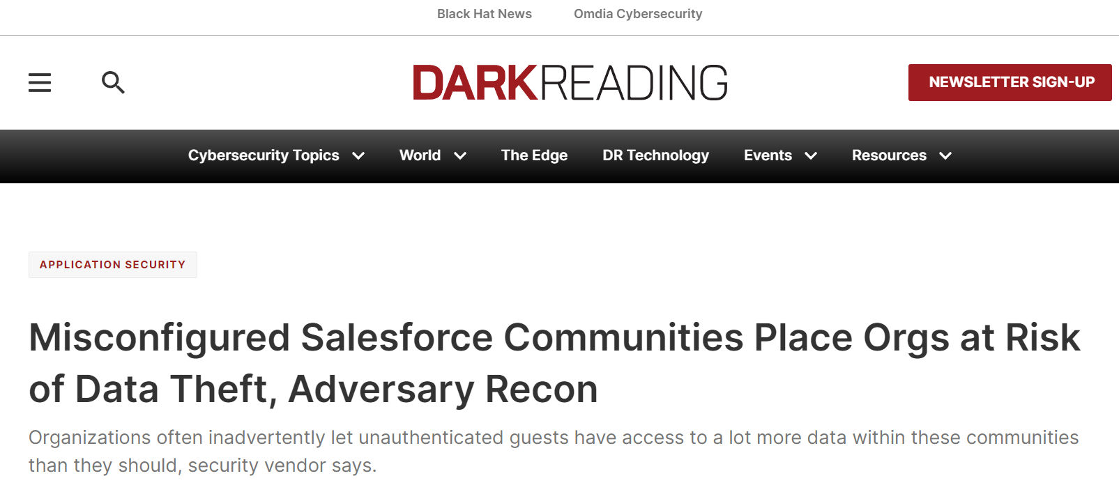
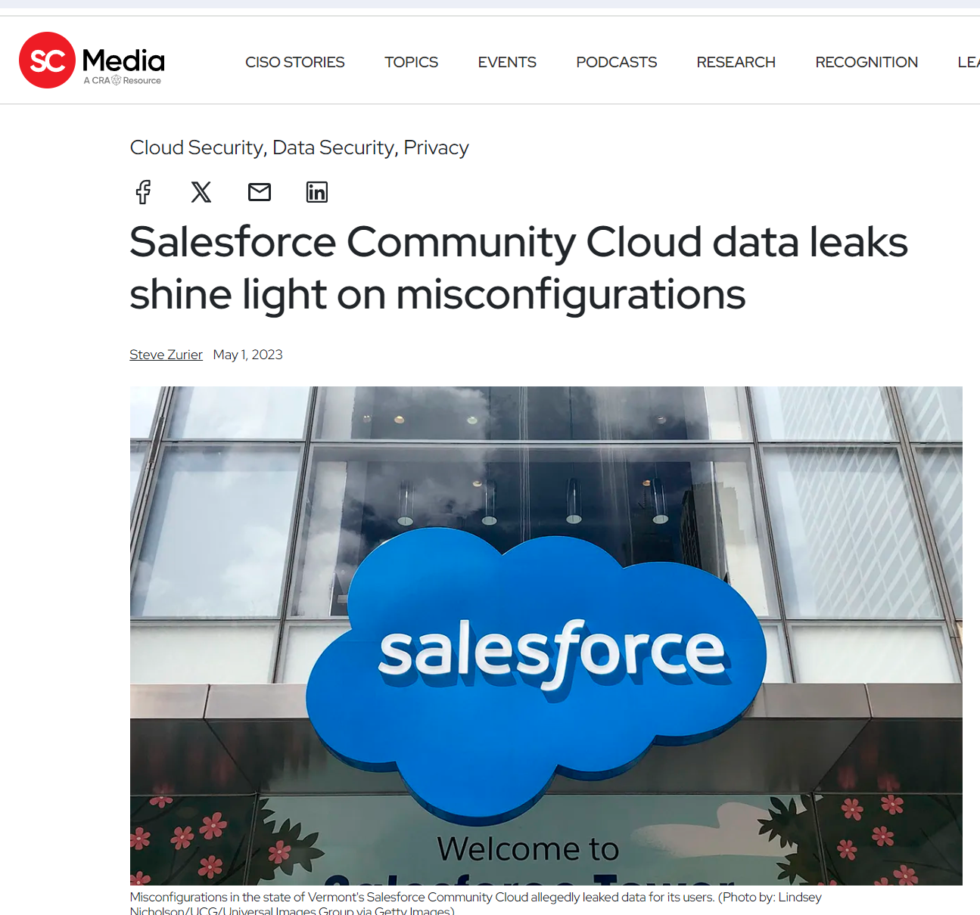
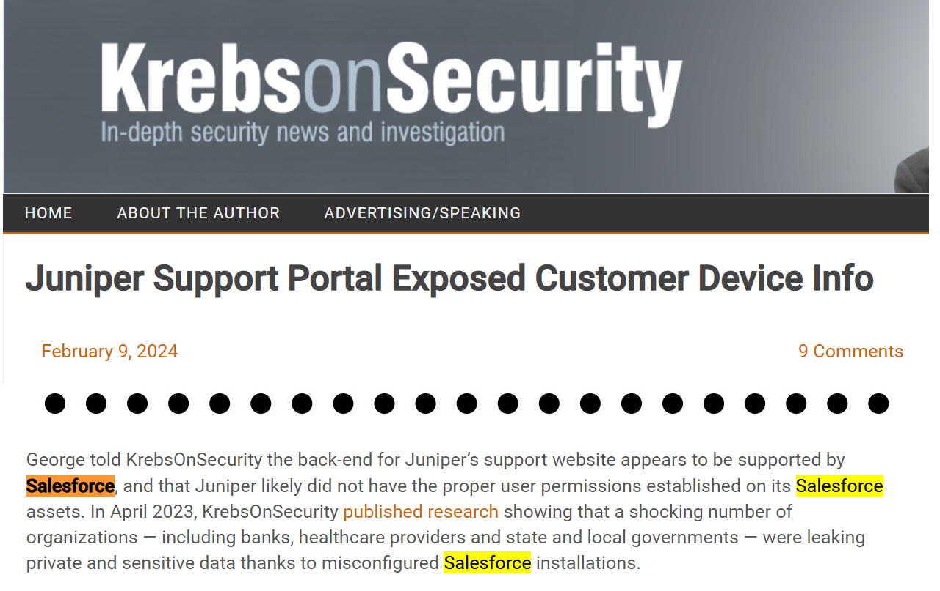
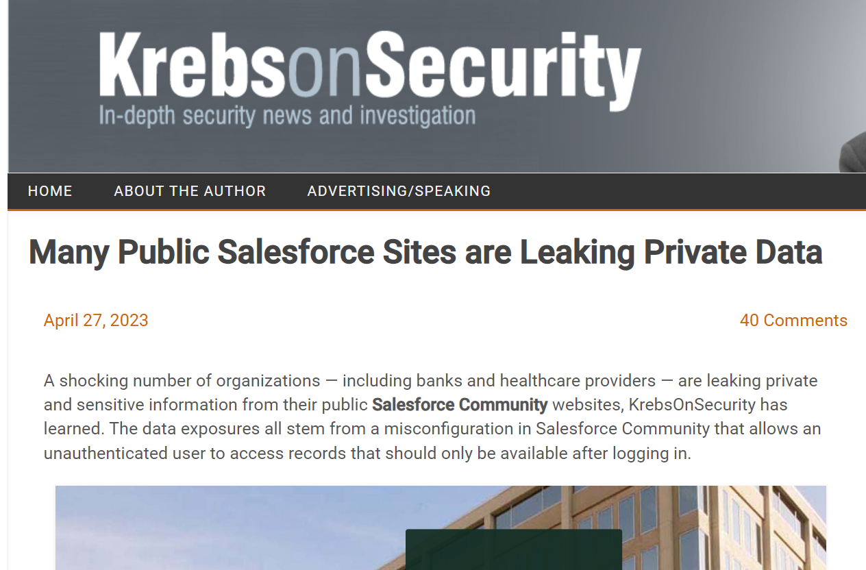
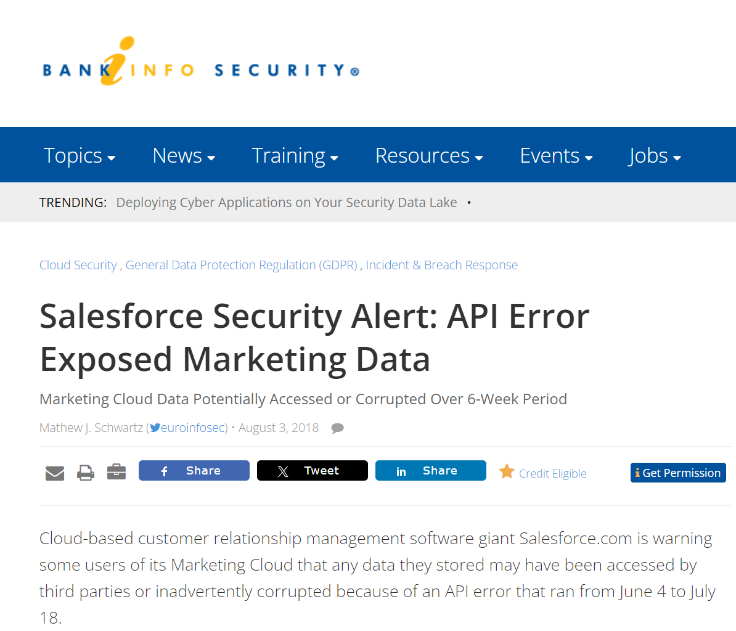
Why Test Custom Salesforce Apps?
https://krebsonsecurity.com/2024/02/juniper-support-portal-exposed-customer-device-info/
https://www.scmagazine.com/news/salesforce-community-cloud-data-leaks-misconfigurations
https://krebsonsecurity.com/2023/04/many-public-salesforce-sites-are-leaking-private-data/
https://www.bankinfosecurity.com/salesforce-security-alert-api-error-exposed-marketing-data-a-11278
https://www.darkreading.com/application-security/misconfigured-salesforce-communities-place-orgs-at-risk-of-data-theft-adversary-recon

Slide 6
What Not to Test
Know the Salesforce policy -https://www.salesforce.com/company/disclosure/
Spam, Brute Force, Denial of Service
Accessing other customers' data
Attacking Salesforce employees (social engr, etc)
Tests against prod accounts
See salesforce.com Vulnerability Reporting Policy

Slide 7
Download PaaS Cloud Goat
https://github.com/Coalfire-Research/paas-cloud-goat
Installation instructions in the repo
Recommend using a Salesforce Developer Edition account

Slide 8
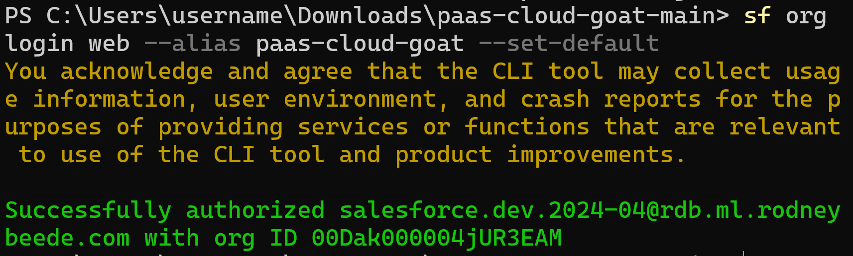
INSTALL.md
sf org login web --alias paas-cloud-goat --set-default

Slide 9
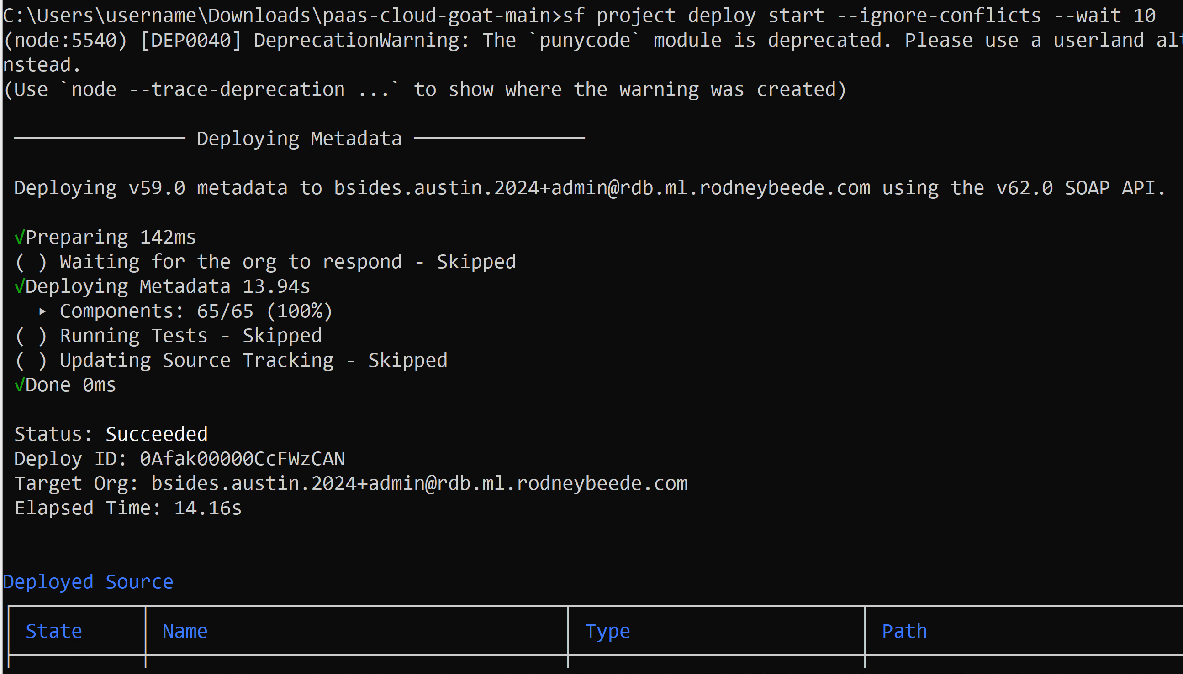
Deploy the App
sf project deploy start --ignore-conflicts --wait 10

Slide 10
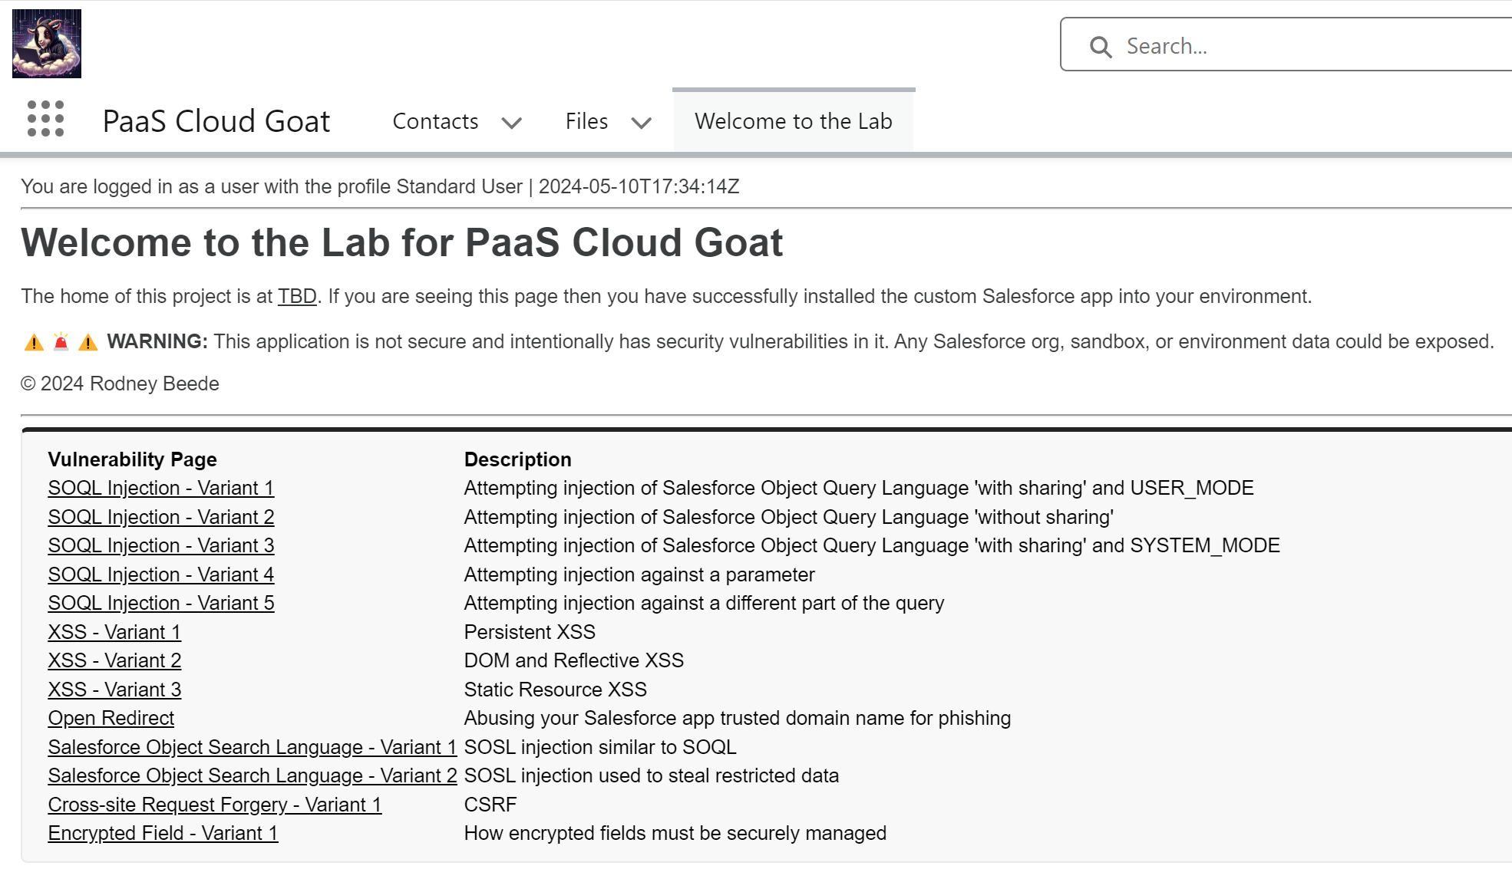

Slide 11
Salesforce Knowledge Tips
How to find Salesforce custom apps
Searching the app menu
Common pen test issue – missing licenses
Test data setup walkthrough
from INSTALL.md
Login as the unprivileged user
Documentation hints
Explain how to things work in Salesforce
Tips for AppSec pen testing

Slide 12
Lightning (LWC) vs Apex
VisualForce = page frontend markup
Apex = backend controller
Lightning = more modern page framework
Replaces Salesforce Classic UI
More AJAX or client-side heavy
Still uses Apex (and optionally) VisualForce
URLs for pentesting
Lightning = https://org.develop.lightning.force.com/lightning/n/XSS2
Apex(Classic) = https://org.develop.vf.force.com/apex/XSS2

Slide 13
Group Activity
Groups of 2-3
Assigned a vulnerability to exploit
Develop a working proof-of-concept
60 minutes
Present to rest of workshop class at end
Hints
Source code analysis is fair game
Stuck? Answer_Key in the repo

Slide 14
Q&A:

